Slide 1

Network Intrusion Detection System
Group:
Raghuvamsi Mallampalli (A04316093) - Section-1
Koushik Reddy Kambham (A04316083) - Section-3
Sai Avinash Vagicherla (A04312707) -Section-4
Jaswanth Sirigiri (A04332429) - Section-4

Slide 2
Contents
Introduction
Literature Survey
Overview & Benefits of Explainable (XAI) Machine Learning
Methodology
Proposed Approach
Implementation
Results & Discussion
Conclusion

Slide 3
Introduction
IoT networks are increasingly targeted by cyber-attacks due to the valuable user data they contain, posing risks to critical services. Traditional security measures face challenges in IoT environments, leading to the development of ML-based intrusion detection systems (IDS).
However, existing systems lack transparency, hindering optimal evaluation and resource allocation. This work aims to enhance understanding of ML-based IDS by surveying Explainable AI (XAI) methods, facilitating transparency in decision-making. Performance metrics will also be measured for accuracy.

Slide 4
Literature Survey
Protecting Internet of Things (IoT) networks is crucial for cybersecurity as IoT is integrated into various applications. Machine learning-based intrusion detection systems are emerging but still minimally applied. Mustafa's study developed an ensemble-based technique using statistical flow features and AdaBoost, showing high performance in detecting normal and malicious activity. Costa's survey highlights various machine-learning techniques applied to IoT security.
In Explainable AI (XAI) literature, a comprehensive publication discusses key concepts and challenges, emphasizing transparency and fairness. Mane and Rao explored XAI in Network Intrusion Detection, proposing a framework using deep neural networks and XAI algorithms like SHAP and LIME to enhance model transparency.

Slide 5
Overview & Benefits of Explainable (XAI) Machine Learning
Advanced ML algorithms enhance IoT network security by analyzing network traffic.
ML techniques support cybersecurity personnel in detecting threats but are often too complex to interpret.
Traditional tools offer more explainability but may lack effectiveness.
Lack of transparency in ML systems decreases trust in predictions.
Explainable AI (XAI) provides intuitive explanations for ML model decisions.
XAI tools aid in understanding model behavior and increasing trust in predictions.

Slide 6
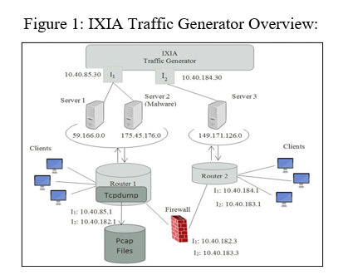
Methodology
Utilizing UNSW-NB15 dataset for IoT network traffic analysis.
Dataset includes normal activities and malicious attack behaviors categorized by attack type.
Created using IXIA PerfectStorm tool in the Cyber Range Lab of ACCS.
Pre-partitioned into training and testing sets.
Training set: 175,341 records, Testing set: 82,332 records.
Features: 39 numeric features, target feature: binary classification of Normal or Attack behavior.

Slide 7
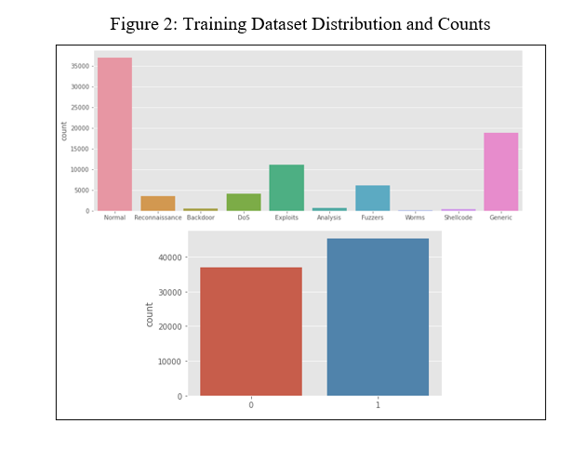
Training Dataset Distribution and Counts
Figure 2

Slide 8
ML Methods:
Decision Trees: Utilizes tree-like model for classification.
Multi-layer Perceptron (MLP): Neural network model for complex tasks.
XGBoost: Gradient-boosted decision trees for efficiency and performance.
Explainability:
ELI5: Visual debugging and explanation library.
LIME: Local interpretable model-agnostic explanations.
SHAP: Shapley Additive explanations for feature impact understanding.

Slide 9
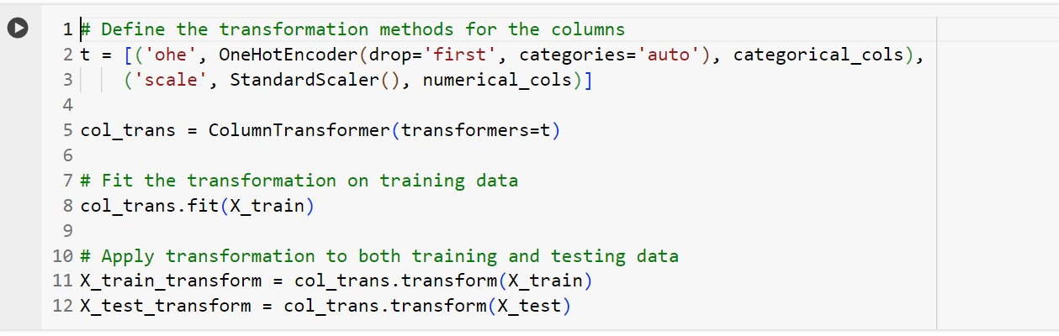
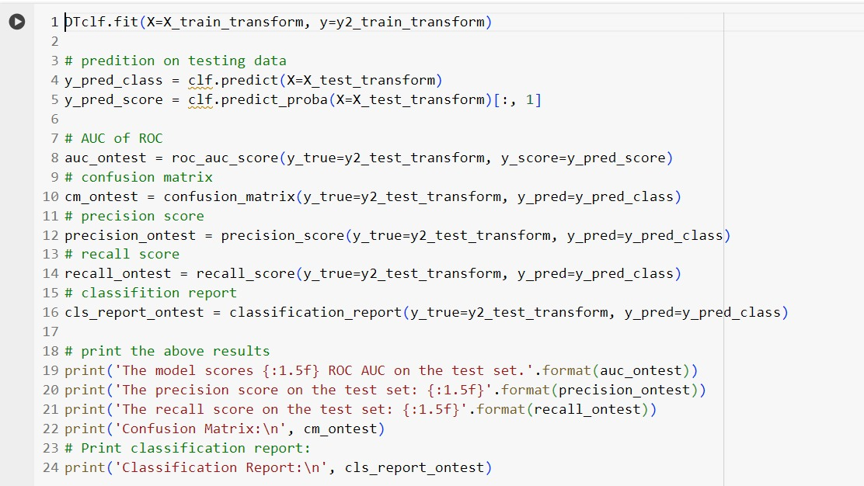
Implementation:
In the preprocessing stage of machine learning, one-hot encoding and categorical encoding are often employed techniques, especially when working with categorical inputs.
For the prediction of attacks algorithms like Decision Tree, XG Boost and Multi-Layer Perceptrons have been used. Explainable AI (XAI) techniques are used for the interpretability of classification predictions, suggesting the feasibility and value of integrating XAI with traditional ML systems for cybersecurity applications.

Slide 10
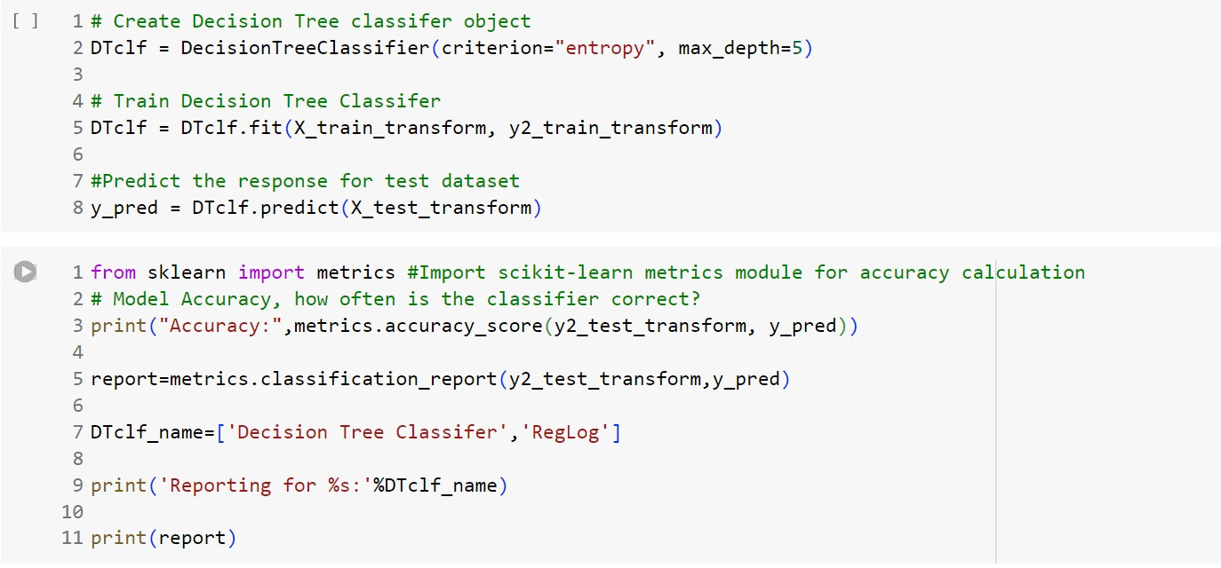
We have considered the several parameters and metrics are used to evaluate the efficiency and performance of a model like Accuracy, Precision, Recall, F1 Score, and ROC Curve.
Finally, we have got 89.89% accuracy using the XGBoost Classifier.

Slide 11
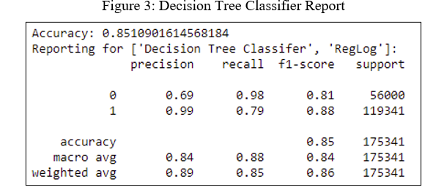
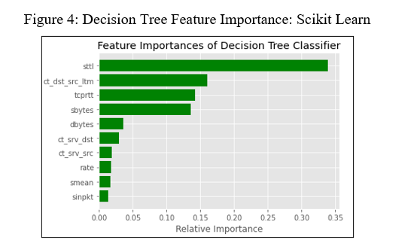
Results & Discussion
Decision Tree Classifier:
Utilized Scikit-learn’s Decision Tree Classifier for training.
Achieved 85% accuracy on testing set.
Feature importance was analyzed using Scikit-learn and ELI5.
‘sttl’ (source to destination time to live value) identified as the most important feature.
Decision tree visualizations provide insight into the classification process.
Offers high accuracy and explainability for IoT network security.

Slide 12
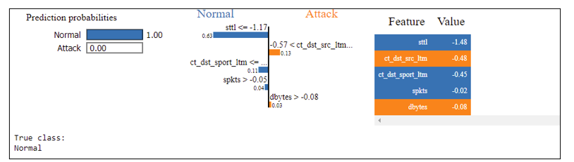
Multi-layer Perceptron (MLP) Classifier:
Achieved 89.83% accuracy on testing set.
Used LIME for individual prediction explanation.
Provides robust explainability for cybersecurity analysis.
Offers transparency despite being a 'black box' algorithm.
Single Classification Prediction using the MLP Classifier Explanation

Slide 13
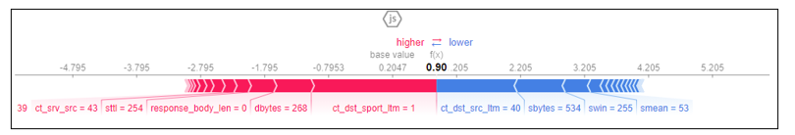
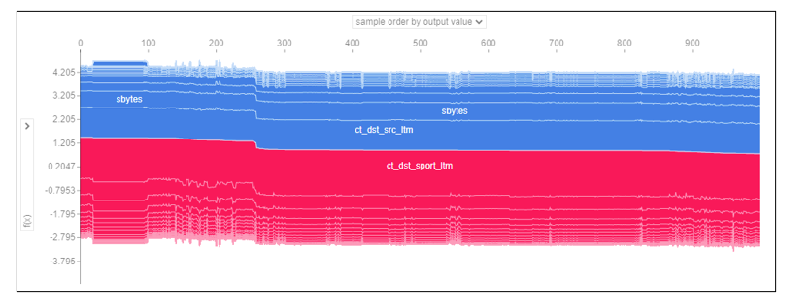
XGBoost Classifier:
Achieved 89.89% accuracy on testing set.
Utilized SHAP for feature importance analysis.
SHAP values indicate feature impact on classification predictions.
Provides insights into individual and collective feature effects.
Offers high performance and flexibility with robust explainability features.
XGBoost SHAP- Visualize a single prediction
XGBoost SHAP - Visualize many predictions

Slide 14
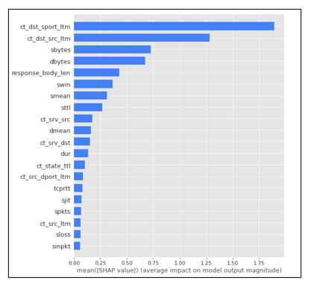
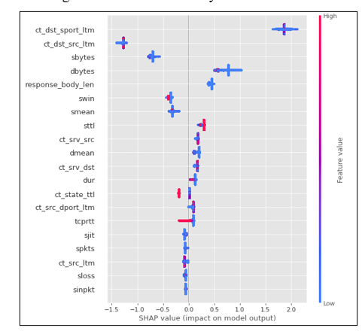
SHAP Feature Importance on XGBoost Classifier
SHAP Summary Plot for XGBoost

Slide 15
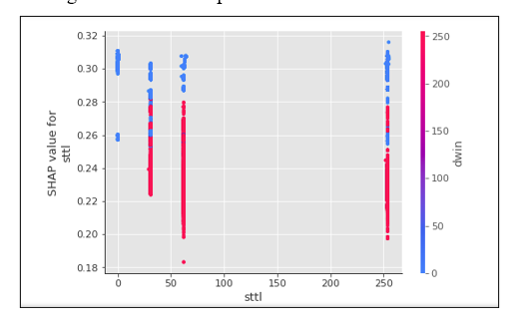
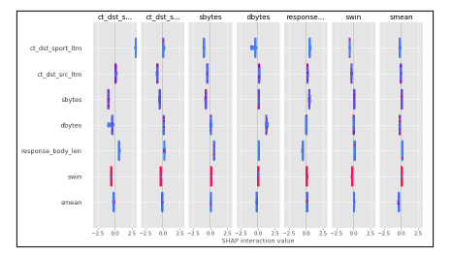
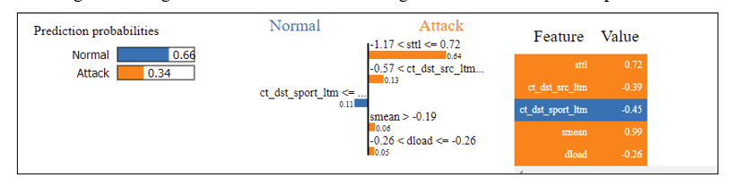
SHAP Dependence Plots for ‘sttl’ feature
SHAP Interaction Value Summary Plot
Single Classification Prediction using the XGBoost Classifier Explanation

Slide 16
Conclusion
ML models in IoT network security are becoming more complex.
Human analysts play a critical role in analyzing outcomes and developing cybersecurity strategies.
ML algorithms often lack interpretability, being perceived as "black boxes".
Utilizing the UNSW-NB15 dataset, Decision Tree, MLP, and XGBoost classifiers achieved high accuracy in analyzing network behavior.
Established XAI techniques were applied to enhance explainability and evaluate feature importance.
Increased transparency enhances trust in ML systems for IoT cybersecurity.
Enables extraction of insights from sophisticated ML models to better predict cyber-attacks.

Slide 17
References
Mane, Shraddha, and Dattaraj Rao. "Explaining Network Intrusion Detection System Using Explainable AI Framework." arXiv preprint arXiv:2103.07110 (2021).
Moustafa, Nour, and Jill Slay. "UNSW-NB15: a comprehensive data set for network intrusion detection systems (UNSW-NB15 network data set)." Military Communications and Information Systems Conference (MilCIS), 2015. IEEE, 2015.
da Costa, Kelton AP, et al. "Internet of Things: A survey on machine learning-based intrusion detection approaches." Computer Networks 151 (2019): 147-157.
Arrieta, Alejandro Barredo, et al. "Explainable Artificial Intelligence (XAI): Concepts, taxonomies, opportunities and challenges toward responsible AI." Information Fusion 58 (2020): 82-115.
Zoghi, Zeinab, and Gursel Serpen. "UNSW-NB15 Computer Security Dataset: Analysis through Visualization." arXiv preprint arXiv:2101.05067 (2021).
García-Magariño, R. Muttukrishnan and J. Lloret, "Human-Centric AI for Trustworthy IoT Systems With Explainable Multilayer Perceptrons," in IEEE Access, vol. 7, pp. 125562-125574, 2019, doi: 10.1109/ACCESS.2019.2937521.
Wang Z: Deep learning-based intrusion detection with adversaries. IEEE Access. 2018;6:38367–384.

Slide 18
Thank You..!

